Slide 1
Fourth Normal Form

Slide 2
Multivalued Dependency
Multivalued dependency occurs when two attributes in a table are independent of each other but, both depend on a third attribute.
A multivalued dependency consists of at least two attributes that are dependent on a third attribute that's why it always requires at least three attributes.

Slide 3
Multivalued Dependency
If A->->B(read as A multi determines B) exists, for a single value of A, more than one value of B exists.
Table should have at least three columns.
For the table with A,B,C as three attributes, B and C should be independent.
If all the above conditions are true, then the table may be in multivalued dependency.

Slide 4
Multivalued Dependency
Std-ID | Course | Hobby
21 | Computer | Dancing
21 | Math | Singing
34 | Chemistry | Dancing
74 | Biology | Cricket
59 | Physics | Hockey
Here Course and Hobby are independent of each other but Course is
dependent on Std-ID and Hobby is dependent on Std-ID.

Slide 5
Fourth Normal Form
A relation will be in 4NF if it is in Boyce Codd normal form and has no multi-valued dependency.
For a dependency A → B, if for a single value of A, multiple values of B exists, then the relation will be a multi-valued dependency.

Slide 6
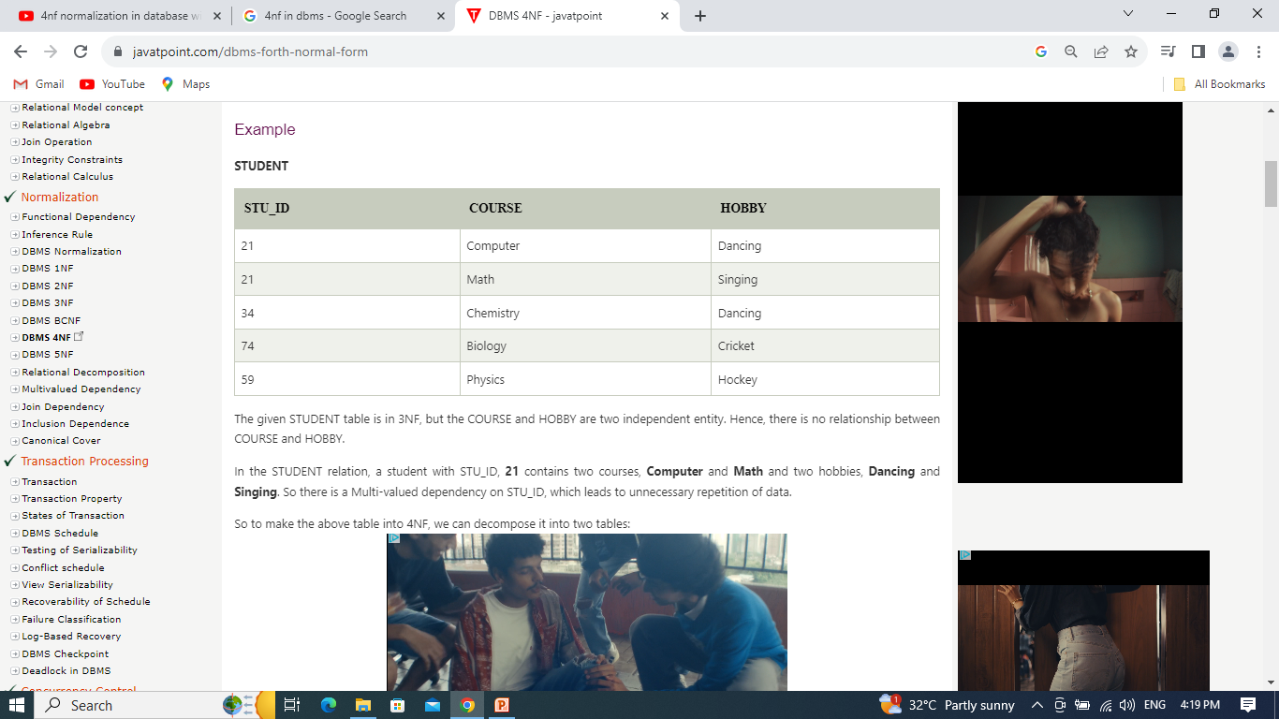
Fourth Normal Form

Slide 7
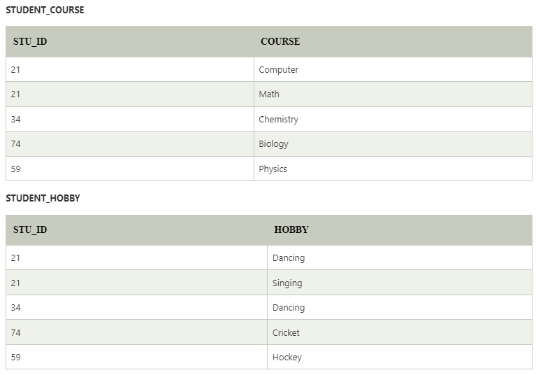
Fourth Normal Form

Slide 8
Fifth Normal Form
A relation is in 5NF if it is in 4NF and no join dependency exists.
It can’t be further non loss decomposed.
5NF is satisfied when all the tables are broken into as many tables as possible in order to avoid redundancy.
5NF is also known as Project-join normal form (PJ/NF).

Slide 9
Join Dependency
If the join of R1 and R2 over C is equal to relation R, then we can say that a join dependency (JD) exists.
Where R1 and R2 are the decompositions R1(A, B, C) and R2(C, D) of a given relations R (A, B, C, D).
Alternatively, R1 and R2 are a lossless decomposition of R.
A JD ⋈ {R1, R2,..., Rn} is said to hold over a relation R if R1, R2,....., Rn is a lossless-join decomposition.

Slide 10
Example
Agent | Company | Product
A1 | PQR | Nut
A1 | PQR | Bolt
A1 | XYZ | Nut
A1 | XYZ | Bolt
A2 | PQR | Nut
Agent | Company
A1 | PQR
A1 | XYZ
A2 | PQR
Agent | Product
A1 | Nut
A1 | Bolt
A2 | Nut
Company | Product
PQR | Nut
PQR | Bolt
XYZ | Nut
XYZ | Bolt

Slide 11
Thank You

